Slide 1
Internet of Things
Module 10
In this presentation:
Introduction to IoT | Lab Exercises (Part One)
Arduino | Lab Exercises (Part Two)
Raspberry Pi (RPi)
Internet of Things

Slide 2
Introduction
The Internet of Things (IoT) is "a global infrastructure […] interconnecting (physical and virtual) things based on existing and evolving interoperable information and communication technologies." These interconnected "things" can include appliances, phones, wearable electronics, or any other everyday device that can be connected to the Internet.
This new category of devices is made possible by the increasing availability of low-cost broadband Internet access, and by the availability of small and inexpensive embedded computers, which are typically built into a device and are dedicated to controlling or monitoring the device.
Internet of Things > Introduction

Slide 3
Introduction (cont’d)
These embedded computers often take the form of a system on a chip (SoC), with all the components of the computer integrated into a single chip. They also take the form of microcontrollers, which are even smaller single-chip computers that are typically optimized for device monitoring and control.
These embedded computers are like conventional computers, in the sense that they also contain a processor and memory and execute software written by a programmer. However, they are typically smaller and more efficient, and depending on the application, they may lack a traditional user interface (such as a keyboard and mouse, or even a monitor/screen).
Internet of Things > Introduction

Slide 4
Introduction (cont’d)
In this module, we will work with two popular examples of these categories of embedded computers: the Raspberry Pi (RPi), a single-board computer based on an SoC, and the Arduino, a project-oriented microcontroller platform.
The RPi is compatible with an embedded version of Microsoft Windows 10 called Windows 10 IoT, which is already installed on the SD memory card included with the RPi in your kit. Both the RPi and the Arduino platforms are provided with tools and examples, and are popular among students of computer science for the exploration of computer programming.
Internet of Things > Introduction

Slide 5
Lab Exercises (Part One)
In the first part of this module, you will:
Launch the Arduino Integrated Development Environment (IDE) and open a sample Arduino program
Construct a simple circuit on a breadboard consisting of four signal LEDs, connected to the output pins of the Arduino
Test the Arduino program, which should use the LEDs to create a pattern of lights under software control.
Modify the program to create other patterns.
(See the lesson plan instructions for more information.)
Internet of Things > Lab Exercises (Part One)

Slide 6
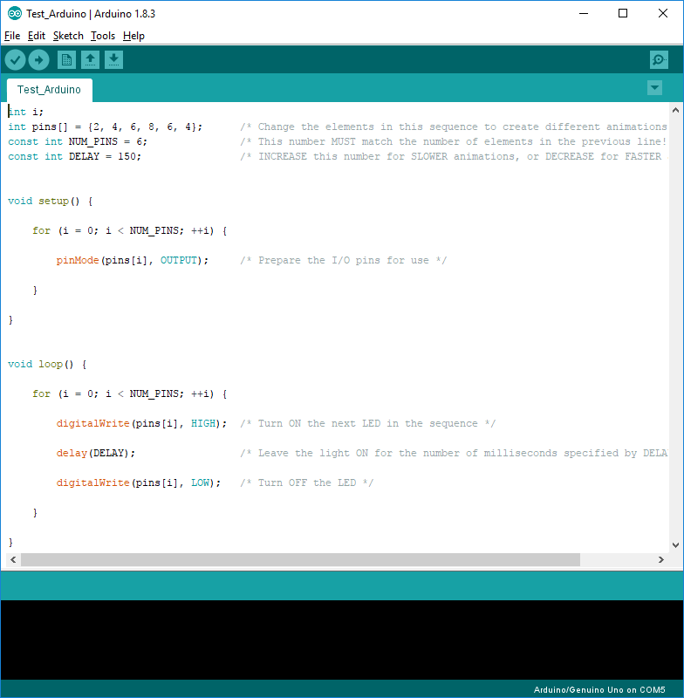
Lab Exercises (Part One) (cont’d)
The Arduino IDE, showing the sample program provided in Part One. After changing this program, click “→” to download it to the Arduino.
Internet of Things > Lab Exercises (Part One)

Slide 7
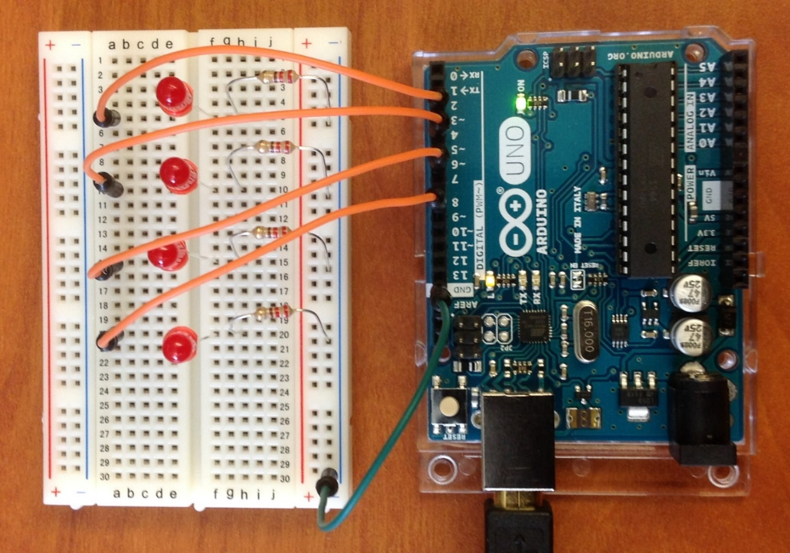
Lab Exercises (Part One) (cont’d)
The Arduino project board, connected to a fully-assembled LED circuit. This circuit has been assembled on a breadboard for rapid prototyping.
Internet of Things > Lab Exercises (Part One)

Slide 8
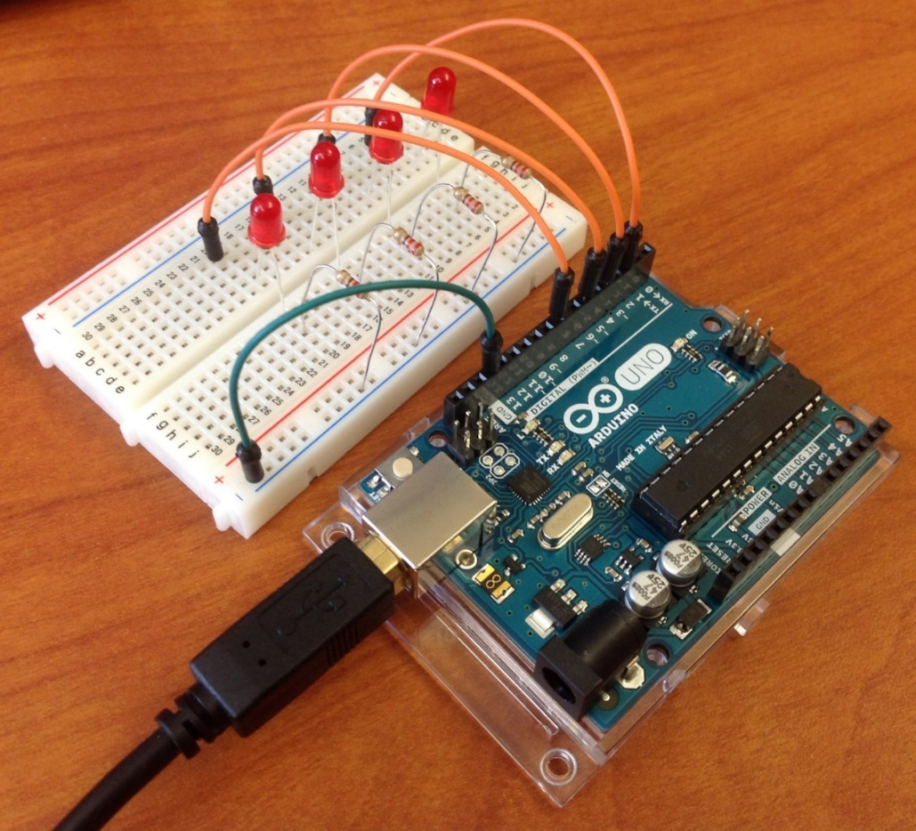
Lab Exercises (Part One) (cont’d)
Another view of the Arduino and breadboard. (In both pictures, the contact points have been highlighted in red to make them easier to see.)
Internet of Things > Lab Exercises (Part One)

Slide 9
Lab Exercises (Part Two)
In the second part of this module, you will:
Download the Arduino portion of a sample home automation application to your Arduino project board.
Prepare and test the Raspberry Pi (RPi): insert the SD card containing Windows 10 IoT, connect the RPi to an HDMI monitor, and test connectivity to the RPi by developing a simple test program using Microsoft Visual Studio.
Download the RPi portion of the sample home automation application to the RPi, connect the Arduino and RPi together, and test the complete application.
(See the lesson plan instructions for more information.)
Internet of Things > Lab Exercises (Part Two)

Slide 10
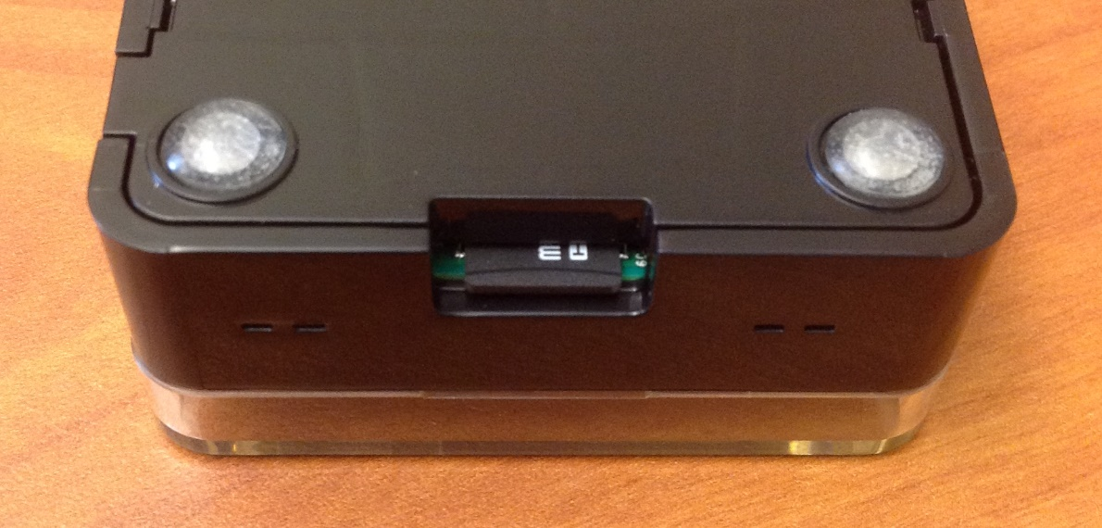
Lab Exercises (Part Two) (cont’d)
The Raspberry Pi (RPi) board, installed in its plastic enclosure, with the Windows 10 IoT SD card included in your kit. Insert the card as shown.
Internet of Things > Lab Exercises (Part Two)

Slide 11
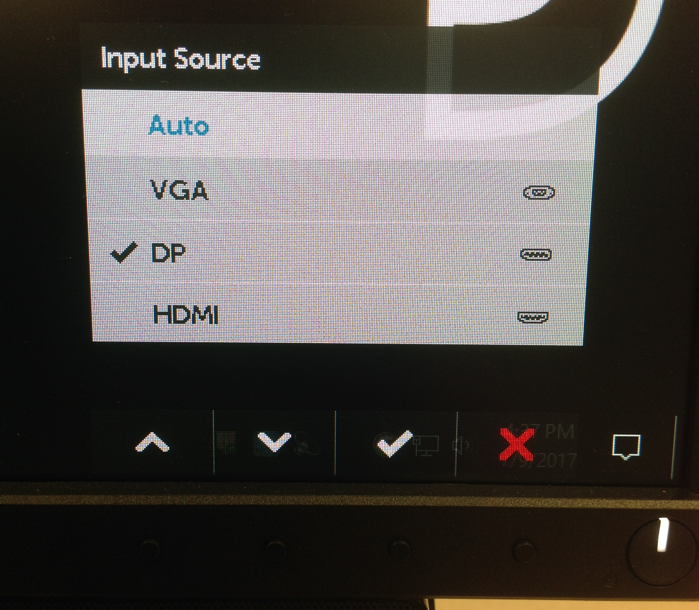
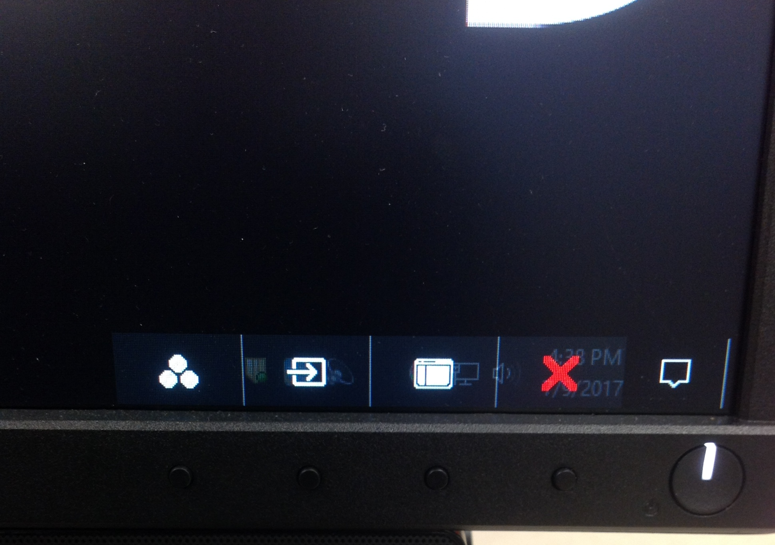
Lab Exercises (Part Two) (cont’d)
1
2
3
1
2
3
To switch monitor inputs in the JSU lab: Press Button 2 (second from left) to enter the menu shown on the left, then press it again to open the input menu. Move the selector UP or DOWN with Buttons 1 and 2, then press Button 3 to select the input. “DP” (DisplayPort) is used by your workstation, and “HDMI” is used by the RPi.
Internet of Things > Lab Exercises (Part Two)

Slide 12
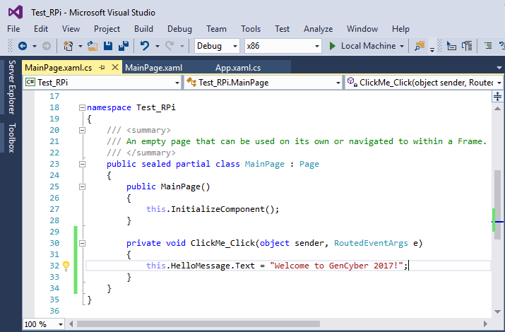
Lab Exercises (Part Two) (cont’d)
Windows Visual Studio, showing a portion of a sample program. The solution configuration and platform settings are circled.
Internet of Things > Lab Exercises (Part Two)

Slide 13
Lab Exercises (Part Two)
If you encounter any difficulties building or deploying your RPi applications from Visual Studio, try the following:
Open the “Build” menu and choose “Clean Solution”, then open the “Build” menu again and choose “Rebuild Solution”, before deploying.
Open the Device Portal page for your RPi (described in the assignment instructions) and uninstall any earlier versions of your application before deploying it again.
Double-check the solution settings and Remote Machine settings to ensure that they are correct for your device.
To check the Remote Machine settings: open the last option (usually the project properties) from the “Debug” menu.
Close and re-open Visual Studio, and restart your RPi, then attempt to build/deploy the application again.
Internet of Things > Lab Exercises (Part Two)

